Slide 1
Measures of Central tendency and dispersion

Slide 2
Measures of Central Tendency
One type of measure useful for summarizing data defines the center or middle of the sample. This type of measure is a measure of central tendency (location).
Notations: Σ is read as Sigma (the Greek Capital letter for S) means the sum of.
Suppose n values of a variable are denoted as X₁, X₂ , X₃ …., X_{n} then ΣX_{i} = X₁,+X₂,+ X₃ +…X_{n} where the subscript i range from 1 up to n.

Slide 3
Introduction
Example:
Let X₁=2, X₂ = 5, X₃=1, X₄ =4, X₅=10, X₆= −5, X₇ = 8
Since there are 7 observations, i range from 1 up to 7
i) (Σx_{i})= 2+5+1+4+10-5+8 = 25
ii) (Σx_{i})² = (25)2 = 625
iii) Σx_{i}² = 4 + 25 + 1 + 16 + 100 + 25 + 64 = 235

Slide 4

1. Arithmetic Mean
One measure of central location for this sample is the arithmetic mean ; it is usually denoted by X̅ .
Definition:
The arithmetic mean is the sum of all observations divided by the number of observations. It is written in statistical terms as:

Slide 5
Example:
Suppose the sample consists of birth weights (in grams) of all live born infants born at a private hospital in a city, during a 1-week period.
2069, 2581, 2759, 2834, 2838, 2841, 3031, 3101, 3200, 3245, 3248, 3260, 3265, 3314, 3323, 3484, 3541, 3609, 3649, 4146
What is the arithmetic mean for the sample birth weights?

Slide 6




Solution
= =

Slide 7
The arithmetic mean is in general, a very natural measure of central location. One of its principal limitations, however, is that it is overly sensitive to extreme values.
It may not be representative of the location of the great majority of the sample points.
The arithmetic mean is a poor measure of central location in these types of sample, since it does not reflect the center of sample.
Nevertheless, the arithmetic mean is by far the most widely used measure of central location.

Slide 8
Characteristics of Mean
Uniqueness(for a given sets of data there is one and only one arithmetic mean).
Simplicity(The arithmetic mean is simple to understood and easy to compute).
It can only be used with quantitative data.
The mean will always exist, but it might not be an actual data value.

Slide 9
Characteristics of Mean cont….
Every data value has an effect on the mean, unlike the median and the mode.
It can be more sensitive to extreme data values than the median.
The sum of the deviations about it is zero.

Slide 10

Mean for a grouped data
This method is applicable where the entire range of available values or scores of the variable has been divided into equal or unequal class intervals and the observations have been grouped into a frequency distribution on that basis.
The value or score (x) of each observation is assumed to be identical with the mid-point (Xc) of the class interval to which it belongs.
In such cases the mean of the distribution is computed as:

Slide 11
Example
Time(Hours) | Frequency(A) | Mid point(B) | A*B
10-14 | 8 | 12 | 96
15-19 | 28 | 17 | 476
20-24 | 27 | 22 | 594
25-29 | 12 | 27 | 324
30-34 | 4 | 32 | 128
35-39 | 1 | 37 | 37
Total | 80 |  | 1655
Therefore; the mean will be
1655/80=20.7 hours

Slide 12
Median
An alternative measure of central location, perhaps second in popularity to the arithmetic mean, is the median.
The rational for these definitions is to ensure an equal number of sample points on both sides of the sample median.

Slide 13
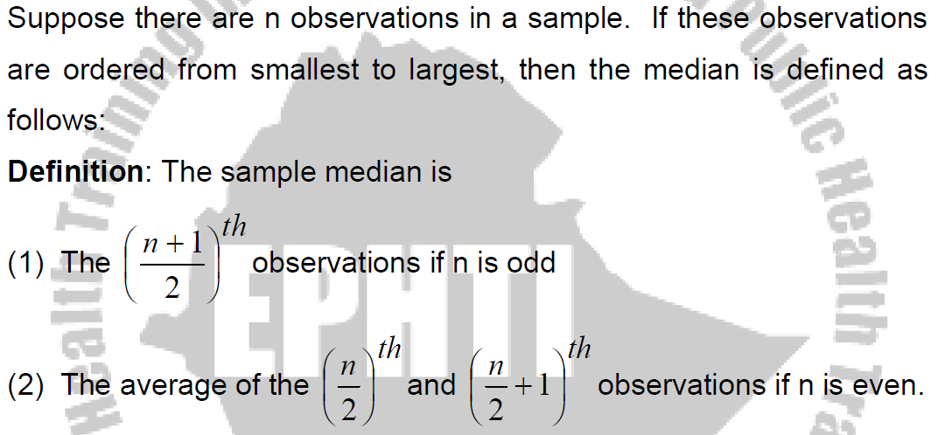

Slide 14
Median Cont…..
Example:
Compute the sample median for the birth weight data
First arrange in Ascending order
2069, 2581, 2759, 2834, 2838, 2841, 3031, 3101, 3200, 3245, 3248, 3260, 3265, 3314, 3323, 3484, 3541, 3609, 3649, 4146
Since n=20 is even,
Median = average of the 10th and 11th largest observation = (3245 + 3248)/2 = 3246.5 g

Slide 15
Median Cont…..
Example:
Consider the following data, which consists of white blood counts taken on admission of all patients entering a small hospital on a given day.
Compute the median white-blood count (×10³ ).
7, 35, 5, 9, 8, 3,10,12, 8
Median?????

Slide 16
Median Cont…
Solution:
First, order the sample as follows. 3, 5, 7, 8, 8, 9, 10,12, 35.
Since n is odd, the sample median is given by the 5th, (9+1)/2)^{th}, largest point, which is equal to 8.
The principal strength of the sample median is that it is insensitive to very large or very small values.
The principal weakness of the sample median is that it is determined mainly by the middle points in a sample and is less sensitive to the actual numerical values of the remaining data points.

Slide 17
Characteristics of Median
Uniqueness.
Simplicity.
It can only be used with quantitative data.
It is the center of the data set in that: at least half of the data value are greater than or equal to it, and at least half of the data value are less than or equal to it.
It can be less sensitive to extreme data values than the mean.

Slide 18
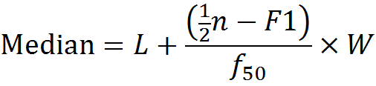



Median in a Grouped data
In the calculation of the median from a grouped frequency table, the basic assumption is that within each class of the frequency distribution, observations are uniformly or evenly distributed over the class interval.
It will be calculated as:-
Where
L= True lower limit of interval containing the median(i.e. the median class
W= Length of the interval
N=Total frequency of the sample
= Cumulative frequency of all interval below L
=Number of observations to be counted off from one end of the distribution to reach the median
=Frequency of the interval containing the median

Slide 19
Example
Time(Hrs) | Frequency(A) | Cumulative Frequency | Mid point(B) | AxB
10-14 | 8 | 8 | 12 | 96
15-19 | 28 | 36 | 17 | 476
20-24 | 27 | 63 | 22 | 594
25-29 | 12 | 75 | 27 | 324
30-34 | 4 | 79 | 32 | 128
35-39 | 1 | 80 | 37 | 37
Total | 80 |  |  | 1655
Median??????

Slide 20
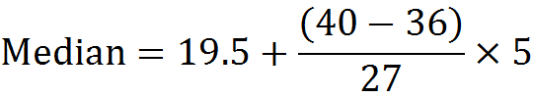
Solution
The Median class
= First class with (n/2)^{th} cumulative frequency
= The first class whose cumulative frequency is at least 40.
= The class whose CF at least 40 is the 3rd class(20-40)
LCB= 19.5
Frequency of the median= 27
CF next below the median class= 36
= 19.5+0.7
=20.2 hours

Slide 21
Mode
It is the value of the observation that occurs with the greatest frequency.
A particular disadvantage is that, with a small number of observations, there may be no mode.
In addition, sometimes, there may be more than one mode such as when dealing with a bimodal (two-peaks) distribution.

Slide 22
Find the modal values for the following data
22, 66, 69, 70, 73 (No modal value)
1.8, 3.0, 3.3, 2.8, 2.9, 3.6, 3.0, 1.9, 3.2, 3.5 (Modal value = 3.0 kg)

Slide 23
Characteristics of Mode
It can be used with quantitative and qualitative data.
The mode won’t always exist, but if it does, it must be an actual value of the data set.
It might not be located near the center of the data values.
It can be less sensitive to extreme data values than both the median and mean.

Slide 24
Skewness
If extremely low or extremely high observations are present in a distribution, then the mean tends to shift towards those scores.
Based on the type of skewness, distributions can be:
Negatively skewed distribution: occurs when majority of scores are at the right end of the curve and a few small scores are scattered at the left end.
Positively skewed distribution: Occurs when the majority of scores are at the left end of the curve and a few extreme large scores are scattered at the right end.
Symmetrical distribution: It is neither positively nor negatively skewed. A curve is symmetrical if one half of the curve is the mirror image of the other half.

Slide 25
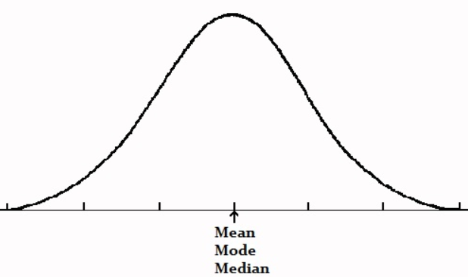
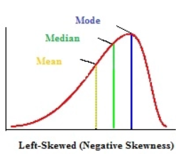
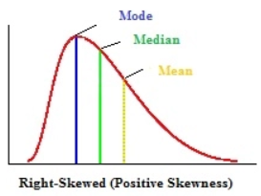
In unimodal (one-peak) symmetrical distributions, the mean, median and mode are identical.
The mean, median and mode occur in alphabetical order when the longer tail is at the left of the distribution.
Or in reverse alphabetical order when the longer tail is at the right of the distribution.

Slide 26
Measures of Variation
Some of the commonly used measures of dispersion (variation) are: Range, Interquartile Range, Variance, Standard deviation and Coefficient of variation.

Slide 27

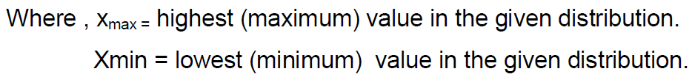
Range
The range is defined as the difference between the highest and smallest observation in the data.
It is the crudest measure of dispersion.
The range is a measure of absolute dispersion and as such cannot be usefully employed for comparing the variability of two distributions expressed in different units.

Slide 28
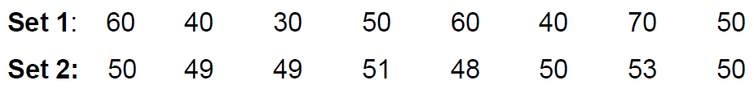
Example:
The range of data in set 1 is 70-30 =40
The range of data in set 2 is 53-48 =5

Slide 29
Characteristics of Range
Since it is based upon two extreme cases in the entire distribution, the range may be considerably changed if either of the extreme cases happens to drop out, while the removal of any other case would not affect it at all.
It wastes information for it takes no account of the entire data.
The extremes values may be unreliable; that is, they are the most likely to be faulty.
Not suitable with regard to the mathematical treatment required in driving the techniques of statistical inference.

Slide 30
Quantiles
Another approach that addresses some of the shortcomings of the range is in quantifying the spread in the data set is the use of quantiles or percentiles.
Intuitively, the P^{th} percentile is the value Vp such that p percent of the sample points are less than or equal to Vp.
The median, being the 50th percentile, is a special case of a quantile.
As was the case for the median, a different definition is needed for the P^{th} percentile, depending on whether np/100 is an integer or not.

Slide 31
Definition:
The p^{th} percentile is defined by
The (k+1)^{th} largest sample point if np/100 is not an integer (where k is the largest integer less than np/100)
The average of the (np/100)^{th} and (np/100 + 1)^{th} largest observation is np/100 is an integer.

Slide 32
Example:
Compute the 10th and 90th percentile for the birth weight data.
2069, 2581, 2759, 2834, 2838, 2841, 3031, 3101, 3200, 3245, 3248, 3260, 3265, 3314, 3323, 3484, 3541, 3609, 3649, 4146
Solution:
Since 20×0.1=2 and 20×0.9=18 are integers, the 10th and 90th percentiles are defined by
10th percentile = the average of the 2nd and 3rd largest values = (2581+2759)/2 = 2670 g
90th percentile=the average of the 18th and 19th largest values = (3609+3649)/2 = 3629 grams.
We would estimate that 80 percent of birth weights would fall between 2670 g and 3629 g, which gives us an overall feel for the spread of the distribution.

Slide 33
Other quantlies which are particularly useful are the quartiles of the distribution.
The quartiles divide the distribution into four equal parts.
The second quartile is the median.
The interquartile range is the difference between the first and the third quartiles.

Slide 34
To compute it, we first sort the data, in ascending order, then find the data values corresponding to the first quarter of the numbers (first quartile), and then the third quartile.
The interquartile range (IQR) is the distance (difference) between these quartiles.

Slide 35
Eg.
Given the following data set (age of patients):
18, 59, 24, 42, 21, 23, 24, 32
Find the interquartile range!
Sort the data from lowest to highest
Find the bottom and the top quarters of the data
Find the difference (interquartile range) between the two quartiles.

Slide 36
18 21 23 24 24 32 42 59
1st quartile = The {(n+1)/4}^{th} observation =(2.25)^{th} observation = 21 + (23-21)x .25 = 21.5
3rd quartile = {3/4 (n+1)}^{th} observation =(6.75)^{th} observation = 32 + (42-32)x .75 = 39.5
Hence, IQR = 39.5 - 21.5 = 18

Slide 37
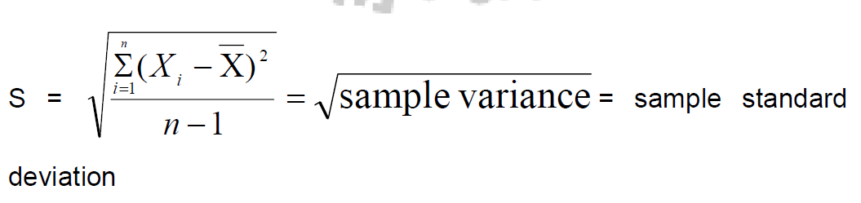
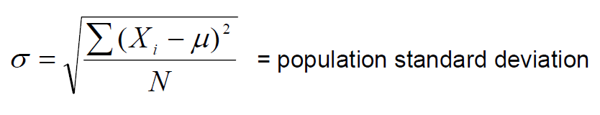
Standard Deviation and Variance
The sample and population standard deviations denoted by S and σ (by convention) respectively are defined as follows:

Slide 38
This measure of variation is universally used to show the scatter of the individual measurements around the mean of all the measurements in a given distribution.
Note that the sum of the deviations of the individual observations of a sample about the sample mean is always 0.

Slide 39
The square of the standard deviation is called the variance.
The variance is a very useful measure of variability because it uses the information provided by every observation in the sample and also it is very easy to handle mathematically.
Its main disadvantage is that the units of variance are the square of the units of the original observations.
The easiest way around this difficulty is to use the square root of the variance (i.e., standard deviation) as a measure of variability.

Slide 40
Example:
Areas of sprayable surfaces with DDT from a sample of 15 houses are as follows (m2) :
101,105,110,114,115,124,125, 125, 130, 133, 135, 136, 137, 140, 145
Find the variance and standard deviation of the above distribution.
The mean of the sample is 125 m² .

Slide 41
Variance (sample) = S² = Σ(xi –x)²/n-1
= (101-125)² + (105-125)²+ …. (145-125)²} / (15-1)
= 2502/14 = 178.71m²
Hence, the standard deviation = = 13.37m²

Slide 42
Coefficient of Variation
Definition:
The coefficient of variation (CV) is defined by: 100% Χ
The coefficient of variation is most useful in comparing the variability of several different samples each with different means.
This is because a higher variability is usually expected when the mean increases and the CV is a measure that accounts for this variability.

Slide 43
The coefficient of variation is also useful for comparing the reproducibility of different variables.
CV is a relative measure free from unit of measurement.
CV remains the same regardless of what units are used, because if the units are changed by a factor C, both the mean and SD change by the factor C; the CV, which is the ratio between them, remains uncharged.

Slide 44
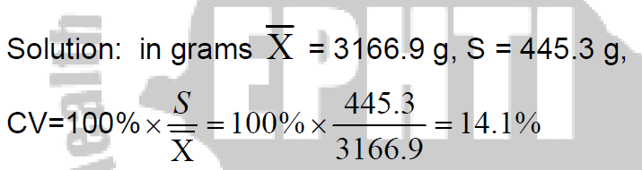
Example:
Compute the CV for the birth weight data when they are expressed in grams
2069, 2581, 2759, 2834, 2838, 2841, 3031, 3101, 3200, 3245, 3248, 3260, 3265, 3314, 3323, 3484, 3541, 3609, 3649, 4146

Slide 45


